Slide 1
Pointers in C

Slide 2
Basic Concepts
In memory, every stored data item occupies one or more contiguous memory cells (each cell is of 1 byte).
–The number of memory cells required to store a data item depends on its type (char, int, double, etc.).
Whenever we declare a variable, the system allocates memory location(s) to hold the value of the variable.
– Since every byte in memory has a unique address, this location will also have its own (unique) address.

Slide 3
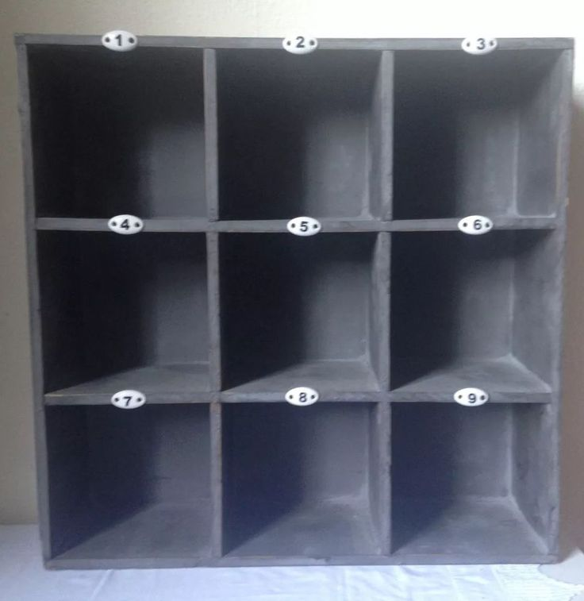


3

Slide 4

1
2
3
4
5
6
7
8
9
10

Slide 5
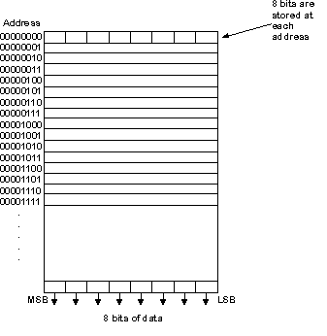

Slide 6
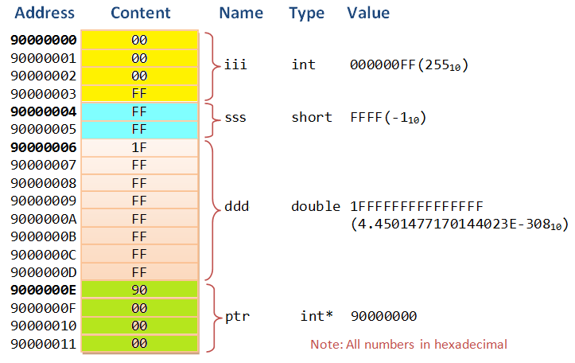

Slide 7
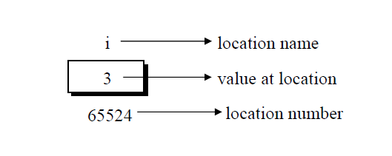
Introduction
Consider the declaration,
int i = 3 ;
This declaration tells the C compiler to:
(a) Reserve space in memory to hold the integer value.
(b) Associate the name i with this memory location.
(c) Store the value 3 at this location.

Slide 8
Contd.
Consider the statement
int xyz = 50;
– This statement instructs the compiler to allocate a location for the integer variable xyz, and put the value 50 in that location.
– Suppose that the address location chosen is 1380.
xyz → Variable
50 → Value
1380 → address (assumption)

Slide 9
Contd.
During execution of the program, the system always associates the name xyz with the address 1380.
– The value 50 can be accessed by using either the name xyz or the address 1380.
“Madam pl give the blue bag”
OR
Give the token and get the bag

Slide 10
Address vs. Value
Each memory cell has an address associated with it.
101 102 103 104 105 ……..
…… ……

Slide 11
Address vs. Value
Each memory cell has an address associated with it.
Each cell also stores some value.
101 102 103 104 105 ……..
…… ……
 |  |  | 50 |  |  | 76

Slide 12
Address vs. Value
Each memory cell has an address associated with it.
Each cell also stores some value.
Don’t confuse the address referring to a memory location with the value stored in that location.
101 102 103 104 105 ……..
…… ……
 |  |  | 50 |  |  | 76

Slide 13
Values vs. Locations
Variables name and memory locations, hold values.
1024
Value
x
Address
Name
32

Slide 14
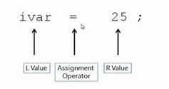
L- Value and R-Value
L-value: “l-value” refers to memory location which identifies an object. l-value may appear as either left hand or right hand side of an assignment operator(=). l-value often represents as identifier.
R-value: r-value” refers to data value that is stored at some address in memory. A r-value is an expression that can’t have a value assigned to it which means r-value can appear on right but not on left hand side of an assignment operator(=).

Slide 15
Introduction to Pointers
Pointer is variable, just like other variables you studied.
– so it has
type,
storage address,
value etc.
A pointer is a variable that holds the memory address of another variable.
Since pointer is also a kind of variable , thus pointer itself will be stored at different memory location.
Difference: it can only store the address (rather than the value) of a data item.

Slide 16
Pointer Declarations
Like any variable, you must declare a pointer before using it to store any variable address.
A pointer is just a C variable whose value is the address of another variable!
• General form:
data_type *pointer_name;
Three things are specified in the above declaration:
• The asterisk (*) tells that the variable pointer_name is a pointer variable.
• pointer_name needs a memory location.
• pointer_name points to a variable of type data_type.
pointer_name
(data_type)
Variable (data_type)
Notes:
‹#›

Slide 17
Cont..
Declaration of pointer
data_type * variable_name;
int *ptr;
int* ptr;
int * ptr;
After declaring a pointer like:
int *ptr;
ptr doesn’t actually point to anything yet. We can either:
– make it point to something that already exists or
– allocate room in memory for something new that it will point to.

Slide 18
Pointer Declarations
Example:
int *count;
float *speed;
int * xp ;
double *salary;

Slide 19
Cont..
int x;
int * xp ;
Pointer to int
int *ip; // pointer to an integer
double *dp; // pointer to a double
float *fp; // pointer to a float
char *ch; // pointer to a character

Slide 20
Pointer
Recall:
Pointer is a variable which can store addresses
Pointer has a “type” (except void pointer)
e.g.
int *p;
char *cp;
double *dp;
Here p, cp, dp are respectively pointers to integer, character, and double
Size of pointer is decided by compiler
Notes:
‹#›

Slide 21
Pointer Initialization
Declaring a pointer just allocates space to hold the pointer – it does not allocate something to be pointed to!
Local variables in C are not initialized by default, they may contain anything.
Once a pointer variable has been declared, it can be made to point to a variable using an assignment statement like:
int *p, xyz;
:
p = &xyz;
– This is called pointer initialization.
Pointer variable can be initialized with NULL or 0 value.

Slide 22
A side note on NULL
NULL is not the number 0
NULL is not necessarily the address 0
NULL is just a special value for pointers told to us by C language.
Very often we need special values for a certain type
E.g. the value '\0' for a character is universally taken to be a special value indicating end of a character sequence in an array
INT_MAX , INT_MIN are values #defined in limits.h for integers
These type of values are used in programs to indicate either an unused variable or empty variable or error value on that variable
Int i = NULL; char c = NULL; works
Why do you want to do it? Instead of saying int i = 0; char c = 0;
Notes:
‹#›

Slide 23
Operations on (and related to) Pointers
&
*
=
+int -int
-
[ ]
Notes:
‹#›

Slide 24
Operations related to pointers: & address / reference operator
& fetches the address of variable
Called Referencing operator
Here, &i is address of i
RHS is address of integer, LHS is variable which can store address of integer
Diagram of this operation is shown on left side
No need of assuming some value for address (e.g. address 1028). Just the diagram is sufficient to understand the concept
int *p, i;
p = &i;
p i
Notes:
‹#›

Slide 25
Operations on pointers: * value at/ dereferencing operator
* fetches the value stored at a given address
Called dereferencing operator
*p : here “value of p” is itself an address (of i), so *p is value stored at “value of p” that is i
Diagram's make it easy to understand, *p is simply the contents of box p points to
int *p, i, j;
i = 10;
p = &i;
j = *p;
10
10
j
p i
Notes:
‹#›

Slide 26
Operations on pointers: *
int *p, i, j;
i = 10;
p = &i;
j = *p;
char *cp, c, d;
c = 'x';
cp = &c;
d = *cp;
What is the difference between * in the two codes?
The *p fetches the value at given address in sizeof(int) bytes, while *cp fetches the value at given address in sizeof(char)=1 bytes
* works based on the size of the type!
10
10
j
p i
'x'
'x'
d
cp c
Notes:
‹#›

Slide 27
Operations on pointers: =
int *p, i, *q;
i = 10;
p = &i;
q = p;
Pointers can be copied
Can arrays be copied?
Thumb rule:
After pointer copy, both pointers point to same location
Common Mistake
One pointer pointing to another
10
p i
q
10
p i
q
Notes:
‹#›

Slide 28
Operations on pointers: +- int
C allows adding or subtracting an int from a pointer!
Weird, but true!
e.g. int *p, n; p + n;
The result is a pointer of the same type
The resultant pointer points n type locations ahead( for +) or before ( for -)
A type location is equal to sizeof(type).
int *p, a[4], *q;
p = &a[1];
q = p + 2;
*q = 40;
a 0 1 2 3
40
p
q
Notes:
‹#›

Slide 29
Problems: Draw diagrams for the code
int main() {
int *p, *q, a[3], b;
a[0] = 10; b = 1;
p = &a[3];
q = p - 3;
p = q + 1;
*(q + 1) = 30;
*(p – 1) = 20;
}
int main() {
int *p, *q, a[3], b;
a[0] = 10; b = 2;
p = &a[1];
q = p + 1;
p = q – b;
*p = 30;
}
Notes:
‹#›

Slide 30
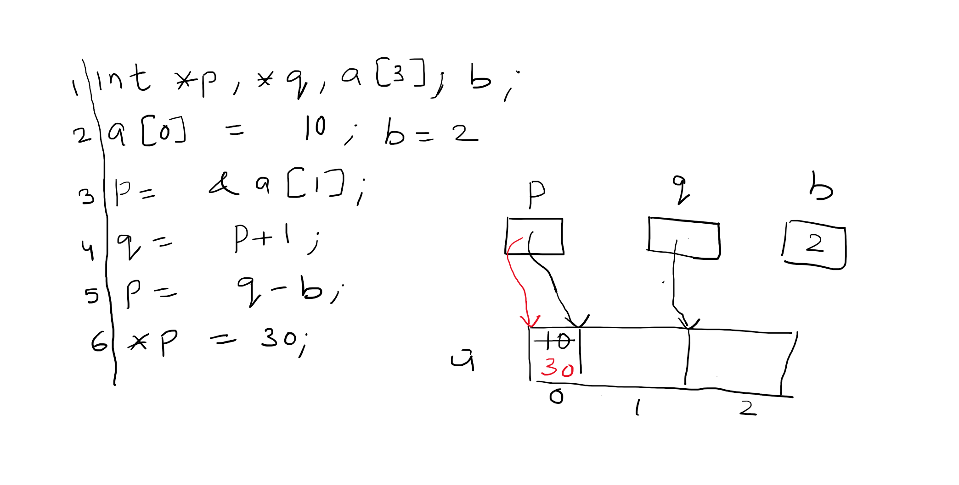

Slide 31
Operations on pointers: substracting two pointers
int *p, a[4], *q, x;
p = &a[1];
q = p + 2;
x = q – p;
Two pointers of the same type can be substracted
Result type is int
Result value = no. Of elements of sizeof(type) between two pointers
Logically derives from adding/substracting int to pointers
p = q + 2 ==> p – q = 2
a 0 1 2 3
2
x
p
q
Notes:
‹#›

Slide 32
Operations on pointers: [ ]
Interestingly, C allows [ ] notation to be applied to all pointers!
You must be knowing that [ ] is normally used for arrays
p [ i ] means * (p + i)
P is a pointer and i is an integer (or i is a pointer and p is a pointer is also allowed)
int *p, a[4], *q;
p = &a[1];
p[2] = 20;
p[-1] = 10;
a 0 1 2 3
10
20
p
Notes:
‹#›

Slide 33
A peculiar thing about arrays
Name of an array is equivalent to the address of (the zeroeth element) the array
int a[3];
Now
a means &a[0]
Because it's an address, it can be stored in a pointer
int a[3], *p;
p = a;
What do the following mean?
int a[3] = {1, 2, 3}, *p;
a + 1;
*(a + 1);
p = (a + 2)
Exception: when passed to sizeof() operator, the name is not the address
a 0 1 2 3
p

Slide 34
Pointer as if it was an array
Combine the concepts of
Pointer arithmetic (+- int)
[ ] notation for pointers
Array name as address of array
int a[3], *p;
p = a;
p[2] = 10;
Here we are using p as if it was an array name
Possible only if p was pointing to array base
a 0 1 2 3
10
p

Slide 35
Pointers != Arrays
Array is a continuous collection of elements of one type.
Array has name, the name also stands for the address of the array
[ ] is allowed operation on arrays
Array name can't be reassigned to another address
Pointer is a variable that can store an address
Pointers can be of various types
[ ], = , +- int, substraction are operations on pointers
Pointers can be reassigned to point to different addresses

Slide 36
Concept of (Binding) “Time”
Compile Time
When you are running commands like
cc program.c -o program
Load time
After you type commands like
./program
Before the main() starts running
Program Run Time
After you type commands like
./program
When the main() of the program starts running, till it exits
Function Call Time
Interval between the call of a function and before the called function starts running. Part of “Run Time”.
Notes:
‹#›

Slide 37
Lifetime of variables and Memory Allocation
int g;
static int t = 20;
int f(int a, int b) {
int x, y;
static int s = 10;
x = a + b + 5 + g + s;
return x;
}
int main() {
int i, j, k, *p;
g = 10; i = 20; j = 30;
p = malloc(8);
k = f(i, j);
}
Global Variables, Static Variables (g, t, and s here)
Allocated Memory at load time
They are alive (available) till the program exits
Local Variables, Formal Arguments (i, j, k in main; a, b, x, y in f)
Allocated Memory on function call
They are alive (available) as long as function is running
Dynamically allocated memory (Run time allocation)
Allocated on explicit call to functions like malloc()
Alive as long as functions like free() are not called on the memory

Slide 38
Dynamic Memory Allocation
Notes:
‹#›

Slide 39
malloc()
malloc() is a standard C library function for allocating memory dynamically (at run time)
#include <stdlib.h> for malloc()
Function prototype
Run “man malloc” to see it
void *malloc(size_t size);
size_t is a typedef in stdlib.h
size_t is unsigned long
Reads a number, allocates those many bytes and returns the address of allocated memory (zero'th byte)
Additional info: malloc() gets the memory from the OS and then gives to your program
Notes:
‹#›

Slide 40
void *
A void pointer is a typeless pointer;
Pure address
No type --> No “size” information about the type
You can declare a void pointer
void *p, *q
Void pointer can store any address
void *p;
int a;
p = &a; char c;
p = &c;
Notes:
‹#›

Slide 41
void *
Void pointers can be copied
void *p, *q;
int a;
p = &a;
q = p;
q also stores address of ‘a’ now
The Dereferencing operator has no meaning when applied to a void pointer
void *p; int a; p = &a;
What does *p mean now?
Needs “size” of the type for its work. Void pointers have no type and so no size information associated with it.
Note: [ ] is also dereferencing
Notes:
‹#›

Slide 42
malloc()
malloc() returns a “void *”
Returns a pure address
This address can be stored in a “void *” variable
This address can also be stored in any pointer variable
Suppose we do
void *p;
p = malloc(8);
Now what meaningful operations can we do with the malloced memory? --> only copy!
So normally return value of malloc is stored using some typed pointer
Notes:
‹#›

Slide 43
malloc()
int *p;
p = malloc(8)
This code allocates 8 bytes and then pointer p will point to the malloced memory
This code can result in a “warning” because we are converting “void *” to a “int *” with '='
Notes:
‹#›

Slide 44
malloc()
int *p;
p = (int *) malloc(8);
This code does away with the warning as we are converting the “void *” into “int *” using explicit type casting
Suppose size of integer was 4 bytes, then what does this code mean?
Notes:
‹#›

Slide 45
malloc()
int *p;
p = (int *) malloc(8);
p points to 8 byte location
However now, *p means deferencing in “4 bytes”
as size of int is 4 bytes
p[0] means *(p + 0) that is *p
p[1] means *(p + 1) where (p + 1) is a pointer 4 bytes ahead of p
Using this trick we are treating the 8 bytes as if it was a 2 integer array !
P + 1
p
0 1 2 3 4 5 6 7
<---------p[0]-------->
<---------p[1]-------->
Notes:
‹#›

Slide 46
malloc()
int *p;
p = (int *) malloc(8);
p points to 8 byte location
However now, *p means deferencing in “4 bytes”
as size of int is 4 bytes
p[0] means *(p + 0) that is *p
p[1] means *(p + 1) where (p + 1) is a pointer 4 bytes ahead of p
Using this trick we are treating the 8 bytes as if it was a 2 integer array !
p
0 1
Notes:
‹#›

Slide 47
Malloc(): Allocating arrays dynamically
int *p;
p = (int *) malloc(
sizeof(int) * 4);
We can allocate arrays of any type dynamically using malloc()
Use of sizeof(int) here makes sure that the code is portable, appropriately sized array will be allocated irrespective of size of integer
Code on earlier slide assumes 4 byte integer
This code allocates array of 4 integers
Can be accessed as p[0], p[1], p[2] and p[3]
Notes:
‹#›

Slide 48
malloc(): Allocating array of structures
typedef struct test {
int a, b;
double g;
}test;
test *p;
p = (test *) malloc(sizeof(test) * 4);
This code allocates an array of 4 structures
p points to the array of structures
p[0] is the 0th structure, p[1] is the 1st structure ...
p[0].a, p[1].g is the way to access the inner elements of structures
Notes:
‹#›

Slide 49
free()
free() will give the malloced memory back
malloc() and free() work together to manage what is called as “heap memory” which the memory management library has obtained from the OS
Usage
void free(void *p);
free() must be given an address which was returned by malloc()
Rule: Every malloc() must have a corresponding free()

Slide 50
DRAW
typedef struct slot { int value; char arr[10]; char *cp; struct slot *sp; }slot; int main() { slot a, b, *p, *q; a.sp = &b; p = &b; q = &a; p->sp = &a; p->cp = &(q->arr[5]); b.cp = &(b.arr[1]); p->value = b.cp - p->cp; q->value = 10; strcpy(b.arr, "hello"); return 0; }

Slide 51
Self Referential Pointers in Structures
Notes:
‹#›

Slide 52
Self Referential Pointers
“Self Referential Pointer” is a kind of a misnomer
C allows structures like this
struct test {
int a;
struct test *p;
};
The pointer p, can point to any variable of the type “struct test” (or be NULL)

Slide 53
Self Referential Pointers
p
Consider following code
typedef struct test {
int a;
struct test *p;
}test;
test x, y, *p, *q;
p = &x;
x.p = &y;
q = &y;
y.p = &y;
x
x
a
p
q
y
a
p
Self referential structures allow us to create a variety of “linked” structures of data

Slide 54
-> notation
typedef struct test {
int a;
struct test *p
}test;
test m, n, *x;
m.a = 20;
x = &n;
(*x).a = 40;
x->a = 50;
x->p = &m;
x->p->p = x;
(*x) is the entire structure to which x points
(*x).a is the variable 'a' in that structure
x->a is another notation for (*x).a
x
m
a
p
20
n
a
p
50

